Slide 1

OBJECTIVES
Be able to write a recursive method
Know what is a circular reference and how to fix it
Be able to write a method to check if 2 object are equal
Understand the difference between object with ID and without ID

Slide 2
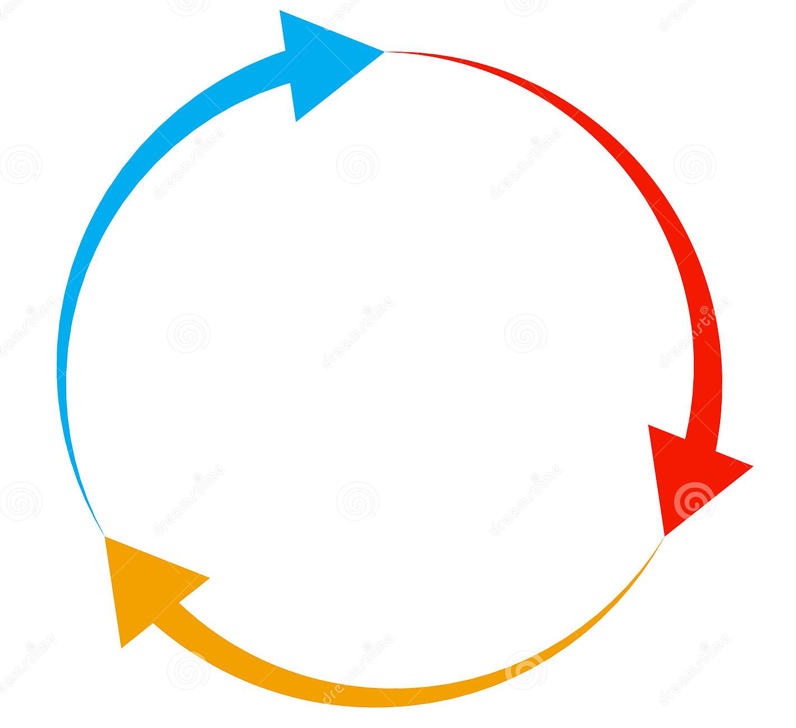
RECURSIVITY & CIRCULAR REFERNCE

Slide 3
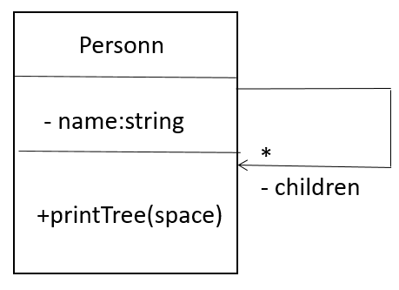
Understand a recursive call
A person can have many children:
We want to print the tree of persons:
RONAN
Ronan has 2 children
Rady and Rith
RADY
HIM
Rady has 1 child
Him
RITH

Slide 4

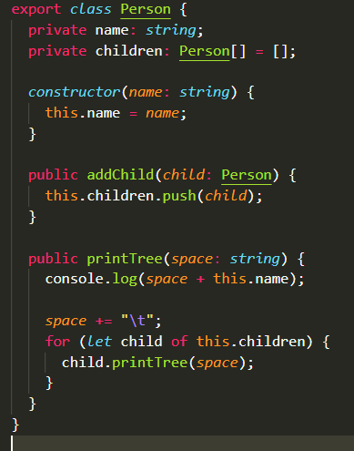
ACTIVITY 1
// 1 – Read the printTree method
// 2 – Understand how we increment the space variable to display the tree of personns
// 3 – Add a child to RITH and another child to RADY

Slide 5
We recursively call the same method on children
Rady instance
Him instance
Call with 1 space
- name: “Rady”
- name: “Him”
Call with 2 space
Ronan instance
+printTree(space)
+printTree(space)
- name: “Ronan ”
Call with 0 space
+printTree(space)
Rith instance
- name: “Rith ”
Call with 1 space
+printTree(space)

Slide 6
ACTIVITY 2
// 1 – Now Ronan is the child of Rady !!!!
// 2 – Run the code and understand see what happen !
Note : to break the code : CTRL + Z

Slide 7
We loop because there is a circular reference
Ronan instance
Rady instance
CALL
CALL
CALL
CALL
Rith instance

Slide 8

Equality of objects

Slide 9
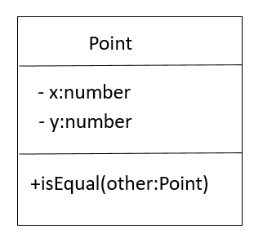
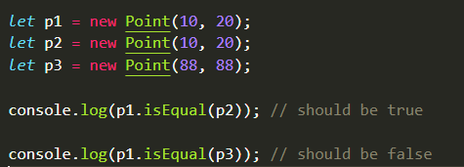
Equality of objects
A point has 2 positions : X and Y
We want to COMPARE 2 points :

Slide 10
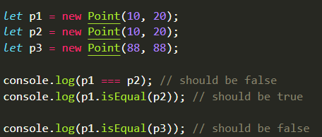
ACTIVITY 3
// 1 – What p1 === p2 return false ?
// 2 – Implement the equal method on Point class
// 3 – Check that p1.equal(p2) return true
// 4 – Check that p1.equal(p3) return false

Slide 11
FOR PRIMITIVE TYPES
number
boolean
string
a : number
45
b : number
45
57896
787875
RAM
number
number
TRUE
We compare by VALUE
a ===
b

Slide 12
FOR OJECT/ARRAY TYPES
Point
p1
p2
x:number
X:45
X:45
y:number
Y:55
Y:55
p1 : object
p2 : object
57896
787875
RAM
object
object
FALSE
We compare the ADDRESS of the objects
p1 ===
p2

Slide 13
Equality of objects
let a = 45;
let b = 45;
let c = a === b
let a = new Person(‘x’);
let b = new Person(‘x’);
let c = a === b
let a = new Person(‘x’);
let b = new Person(‘x’);
let c = a.equals(b)
True because a and b are primitive types
False because a and b are object types
True because now we really compare the 2 persons using their attributes
For primitives == is done is on the value
For object == is done is on the @ in RAM

Slide 14

ID or not ID ?

Slide 15
ACTIVITY 4
Which class should have an ID attribute ?
class Address {
}
class Car {
}
class Date {
}
A
B
C
D
class Student {
}
E
class Point {
}
F
class Computer {
}

Slide 16
ACTIVITY 4
Which class should have an ID attribute ?
class Address {
}
class Car {
}
class Date {
}
A
B
C
D
class Student {
}
E
class Point {
}
F
class Computer {
}

Slide 17
ID or not ID ?
Objects without proper identity do not need ID
Example: Address, Date, Time, Point, Vector
Objects which refer to something unique needs an ID
Example: Student, School, Travel, Bus
class Point {
x: number;
y: number
}
class Student {
id: number;
name: string;
}

Slide 18
isEqual() with id/no id
public isEqual(other: student): boolean {
return this.id === other.id;
}
public isEqual(other: point): boolean {
return
this.x === other.x
&& this.y === other.y;
}

Slide 19
SO !!!
Be able to write a recursive method
Know what is a circular reference and how to fix it
Be able to write a method to check if 2 object are equal
Understand the difference between object with ID and without ID

